Slide 1

Mobile Computing Technology
February 11, 2025

Slide 2
Learning Objective
Explain what a nullable variable is
Several forms of iterations
Accessing Arrays

Slide 3
Kotlin
More of

Slide 4
Nullability
refers to the ability of variables to have an absence of value
Null is the absence of a value.
In C, for some data types, it means a 0
What is an empty string in C? Null?
val name = “Ali”
Val name = “”
val name = null

Slide 5
Null
In Kotlin, you can use null to indicate that there's no value associated with a variable.

Slide 6
Null
In Kotlin, you can use null to indicate that there's no value associated with a variable.

Slide 7
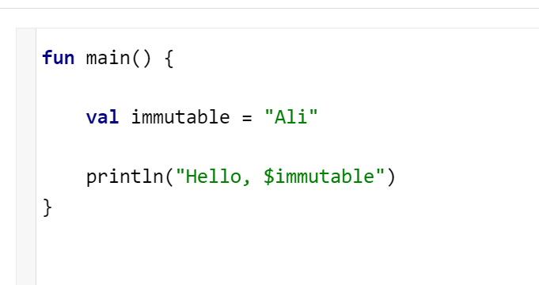
Immutable variables
Try this in Kotlin Playground

Slide 8
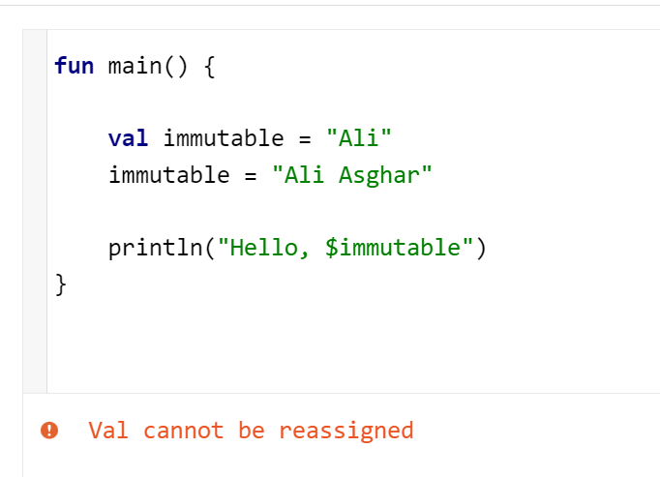
Immutable variables
Try this in Kotlin Playground

Slide 9
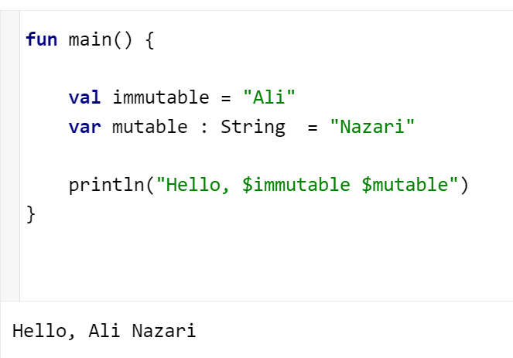
Mutable variables
Try this in Kotlin Playground
Note the keyword we used for declaration
val
var
Notes:
specify that the variable is of the tpe String

Slide 10
Mutable variables
Try this in Kotlin Playground
Note the keyword we used for declaration
val
var

Slide 11
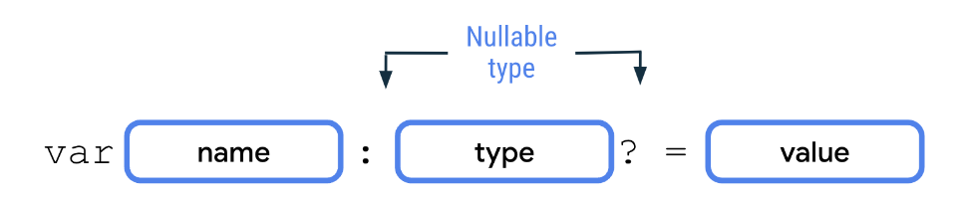
Nullable variables
In Kotlin, there's a distinction between nullable and non-nullable types
A type is only nullable if you explicitly let it hold null
Notes:
Nullable types are variables that can hold null
A type is only nullable if you explicitly let it hold null

Slide 12
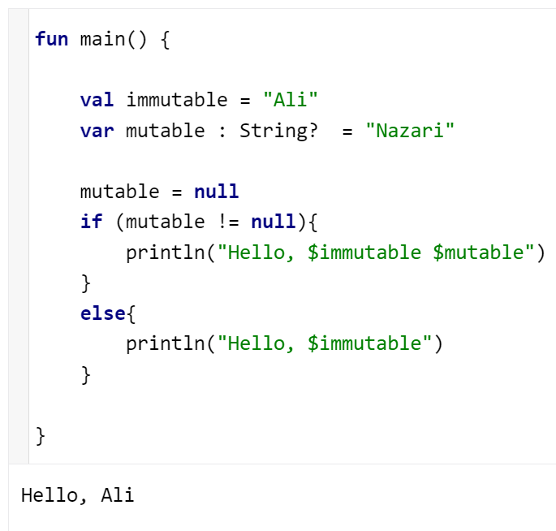
Nullable variables
To declare nullable variables in Kotlin, you need to add a ? operator to the end of the type
These are two different types
String
String?
Notes:
a String? type can hold either a string or null, whereas a String type can only hold a string.

Slide 13
Variable Declaration
fun main() {
val immutable = "Ali"
var mutable : String? = "Nazari"
mutable = null
if (mutable != null){
println("Hello, $immutable $mutable")
}
else{
println("Hello, $immutable")
}
// Can you declare variables anywhere
// in the code or just at the beginning of a block?
// Check it out yourself
}

Slide 14
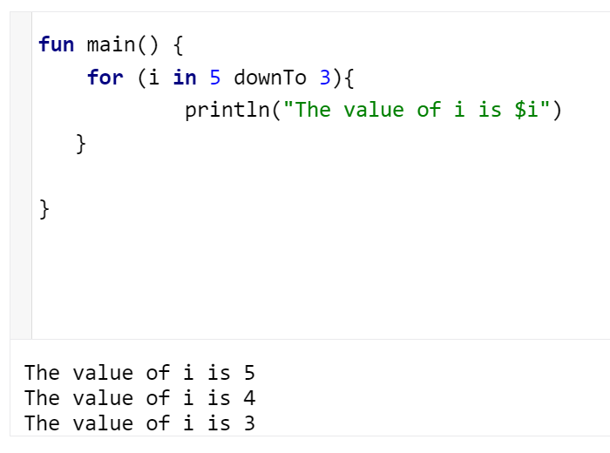
Iteration
Several ways for iteration
Assess the following code
What will be the output of println()

Slide 15
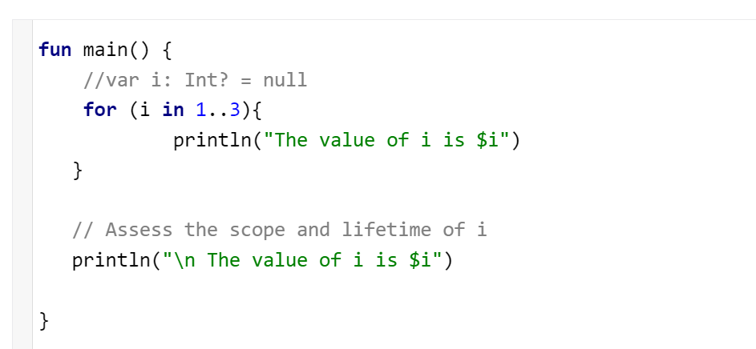

Iteration
Assess the following code
What will be the output of the last println()

Slide 16
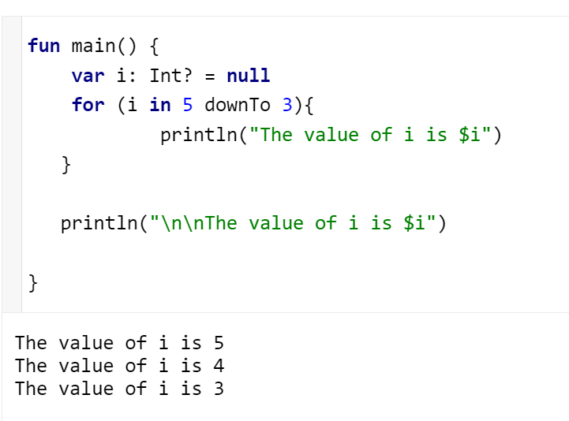
Iteration
Assess the following code
What will be the output of the last println()?

Slide 17
Iteration
Assess the following code
What will be the output of the last println()?

Slide 18
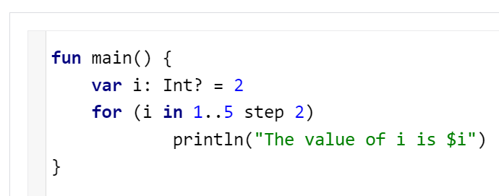
Iteration
Assess the following code
What will be the output of the last println()?

Slide 19
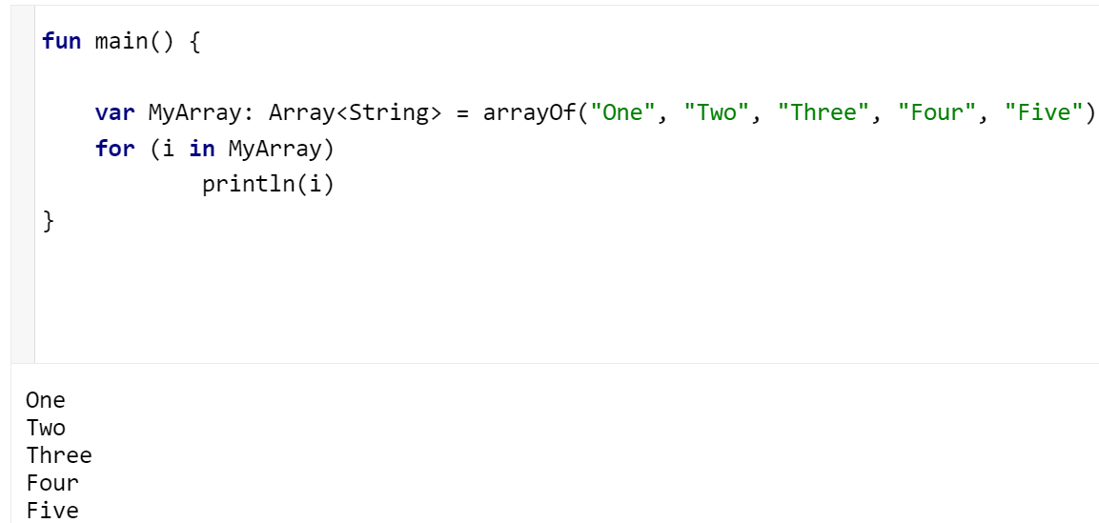
Iteration

Slide 20
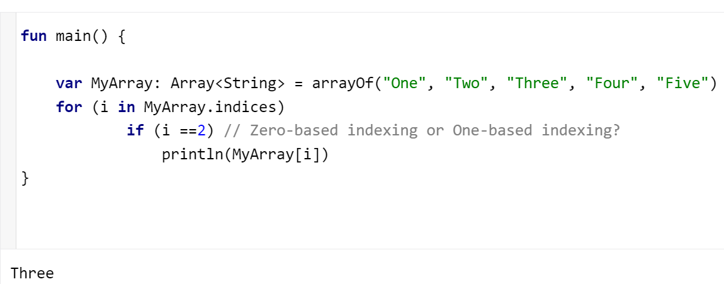
Iteration
Try to print the second element only

Slide 21
Iteration
Try indexing at zero

Slide 22
Iteration
Does Kotlin support range checking?
Can we used negative values for the index range?
Try negative indexing, e.g. MyArray[-1]

Slide 23
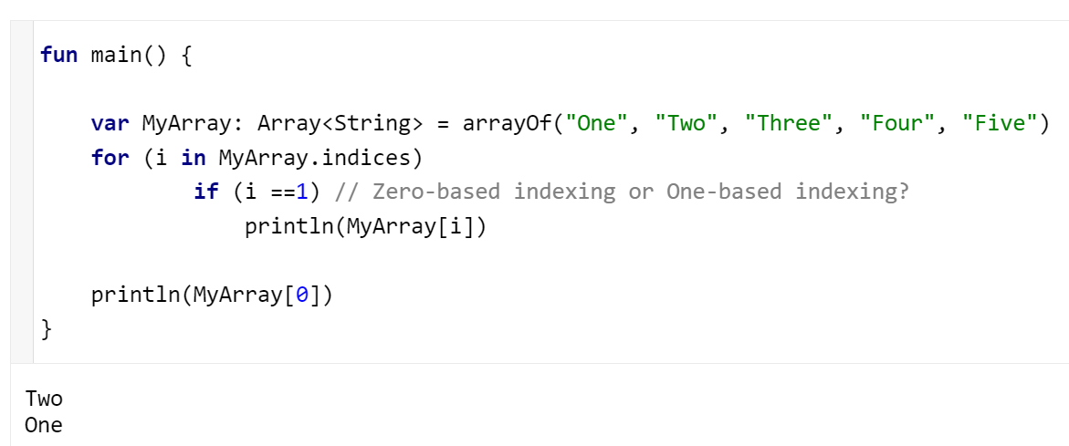
Iteration

Slide 24
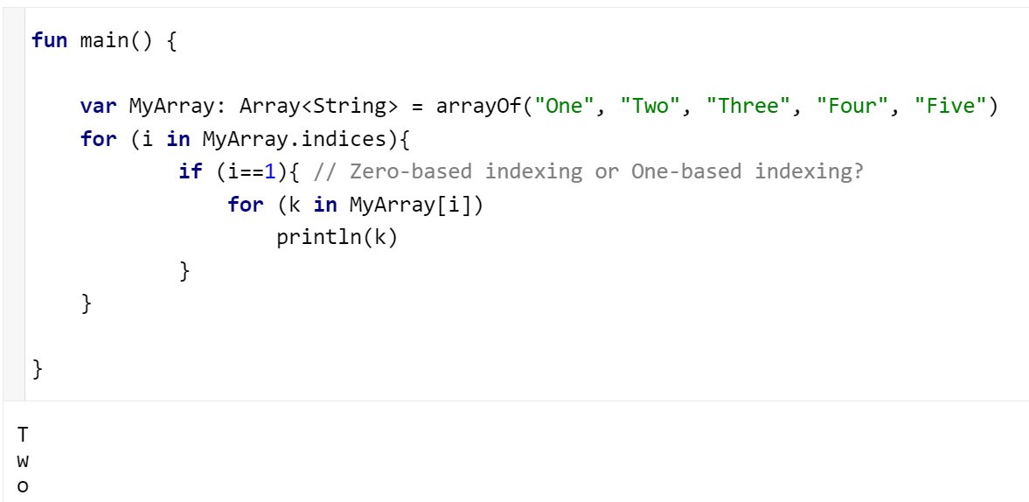
Iteration
Notes:
Try it out
.indices returns all indices of each array element

Slide 25
Summary

